Slide 1

MICRO IT PROJECT
Topic : Process vs Thread

Slide 2
PROCESS VS THREAD
What is a Process?
A process is an instance of a program that is running on a computer. Each process has its own memory space, system resources, and execution context.
Real-Life Example of a Process:
Imagine you have several independent offices within a large office building. Each office (process) has its own workspace, resources, and employees.

Slide 3
PROCESS VS THREAD
What is a Thread?
A thread is a smaller unit of execution within a process. Multiple threads within the same process share the same memory space and resources, allowing for more efficient communication and data sharing. Threads are often referred to as “lightweight processes.”
Real-Life Example of a Thread:
Consider an office (process) where several employees (threads) are working on different tasks. They share the same office space, resources, and information, making it easy to collaborate and communicate directly without the need for external communication tools

Slide 4
SHARED MEMORY VS ISOLATED MEMORY
Shared Memory :
Definition: Shared memory refers to a memory area that is accessible by multiple objects or threads.
OOP, this usually happens through static variables or shared resources, where all instances of a class share the same data.
Example: A static variable in a class that keeps track of the number of objects created.
Isolated Memory :
Definition: Isolated memory refers to memory that is independent and unique to each object.
In OOP, this is achieved through instance variables,
where each object maintains its own copy of the data.
Example: A class where each object has its own name, age, or any other instance data.

Slide 5
SHARED MEMORY VS ISOLATED MEMORY
Feature | Shared Memory | Isolated Memory
Definition | Common memory accessed by multiple objects or threads | Separate memory for each object
Created Using | static variables, singleton objects | Instance (non-static) variables
Scope | Belongs to the class (shared among all instances) | Belongs to each object individually
Access | All objects share the same memory/data | Each object has its own memory/data
Example | Static counter to track number of objects | Each object has its own name, age, etc.
Use Cases | Global counters, shared config, logging | Object-specific data, encapsulated logic
Risk in Threads | Higher (can cause race conditions if not synchronized) | Lower (less chance of data interference)

Slide 6
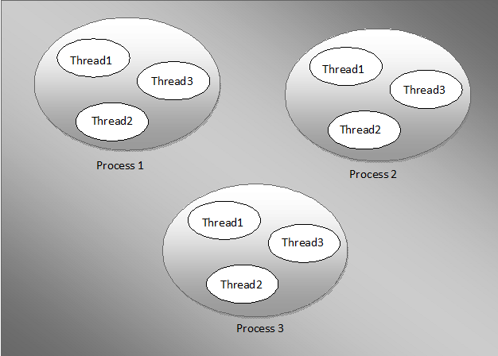
DIAGRAM OF PROCESS AND THREAD

Slide 7
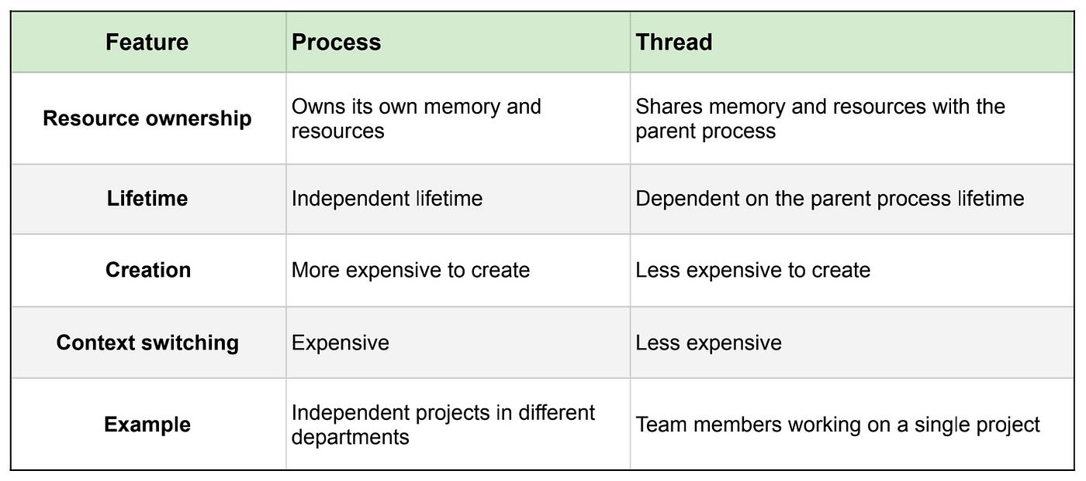

Slide 8


